Slide 1


Self-check 3
Look Back 3
UNIT 3

Slide 2
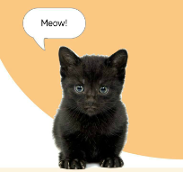
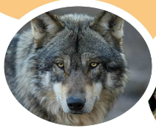
Revise with these quizzes!
https://wordwall.net/play/8876/933/380
https://wordwall.net/play/9059/864/863

Slide 3
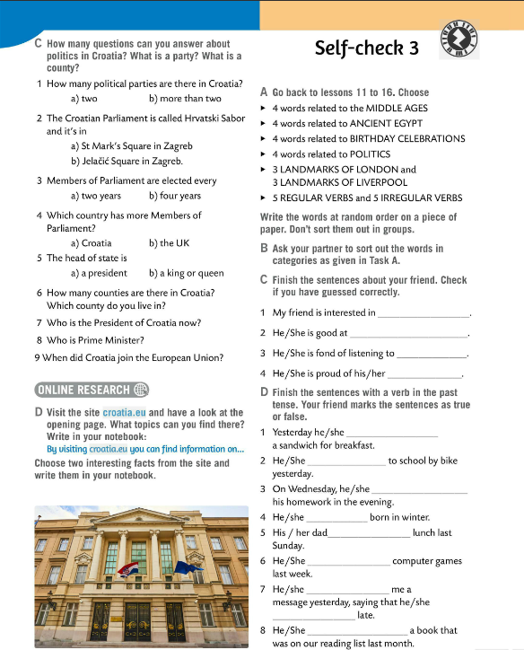
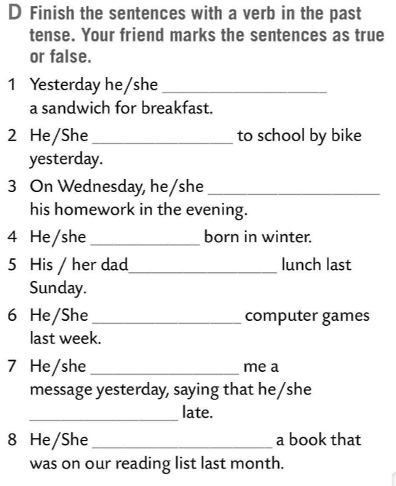
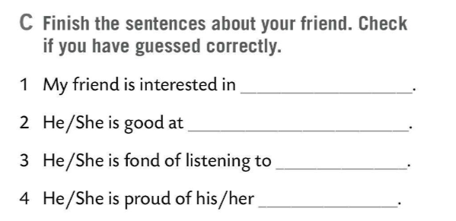
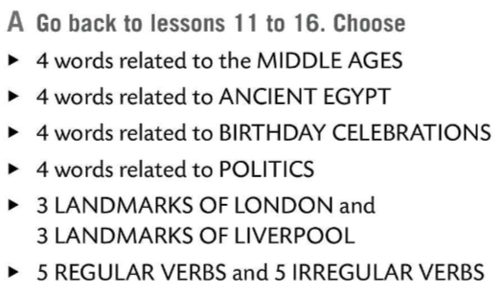
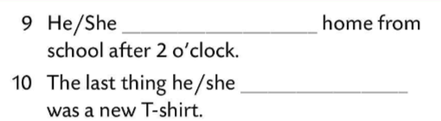
Go back to lessons 11 to 16 and do Task A. Write the words at random order on a piece of paper. Don’t sort them into groups.
Ask your partner to sort out the words in categories as given in Task A.
Finish the sentences about your friend in Task C. Check if you have guessed correctly.
Finish the sentences with a verb in the past tense. Your friend marks the sentences as true or false.

Slide 4
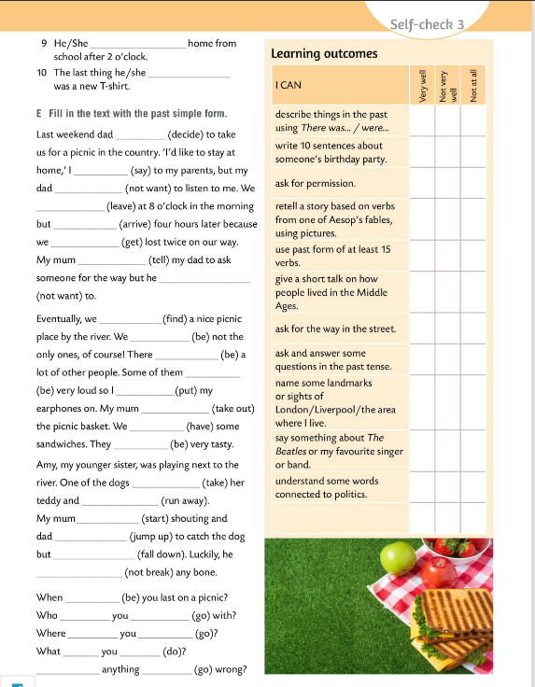
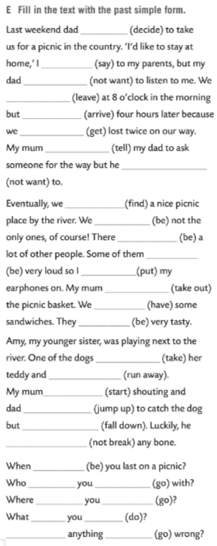
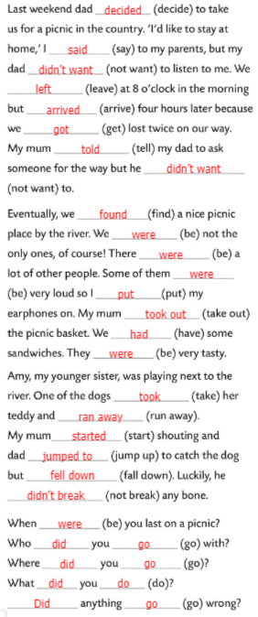
Fill in the text in Task E with the past simple form.
Check.

Slide 5
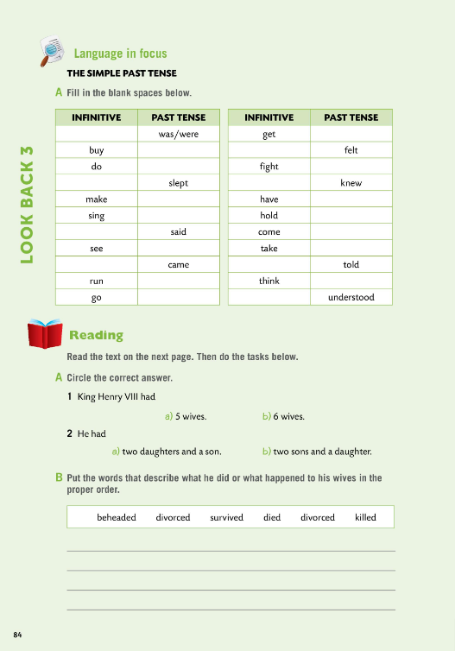

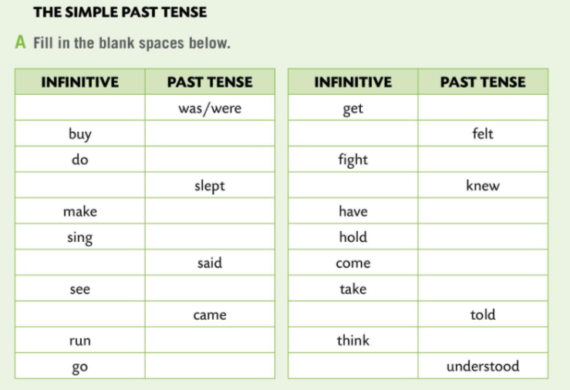
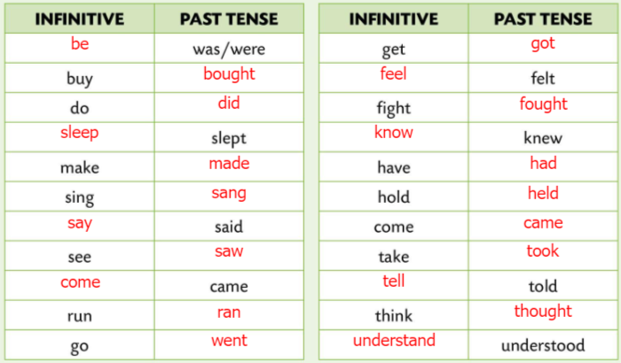
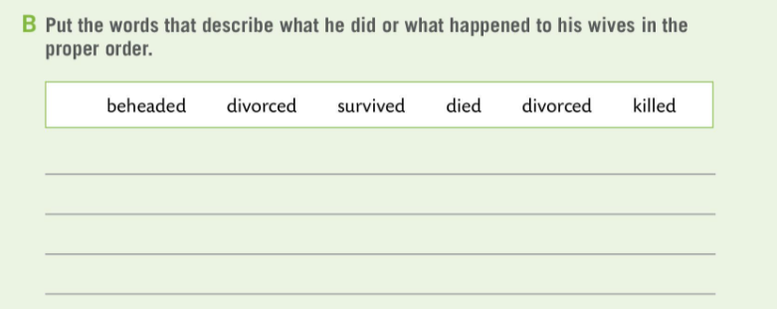
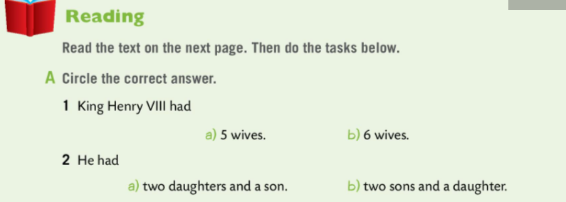
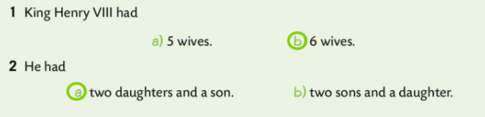
Workbook, page 84. LOOK BACK 3
Fill in the blank space in the table in Task A.
Check.
Read the texts on the next page. Do the tasks below.
Circle the correct answer in Task A.
Check.
Put the words that describe what King Henry VIII did or what happened to his wives in the proper order.
Check.

Slide 6
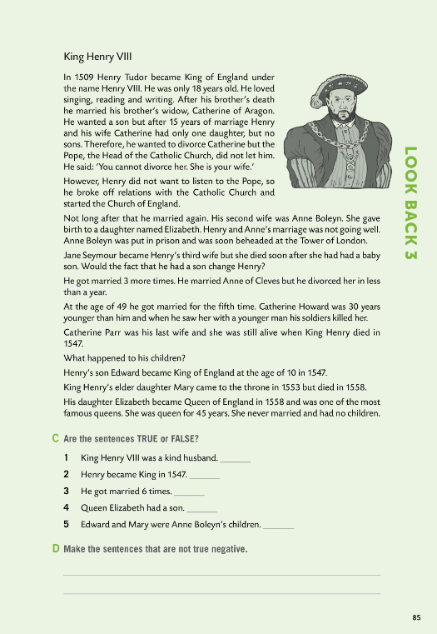
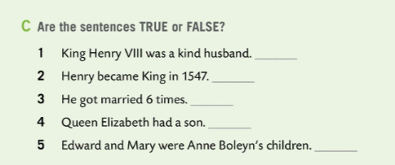
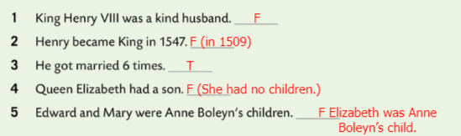
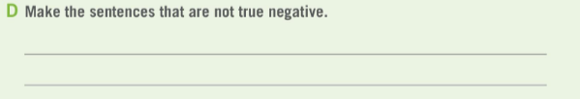
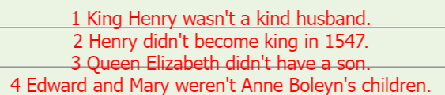
Workbook, page 85. LOOK BACK 3
Are the sentences in Task C TRUE or FALSE?
Check.
Make the sentences that are not true negative.
Check.

Slide 7
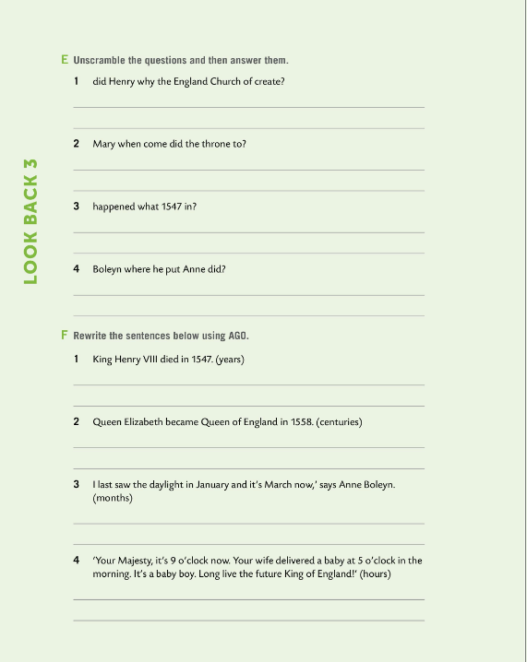
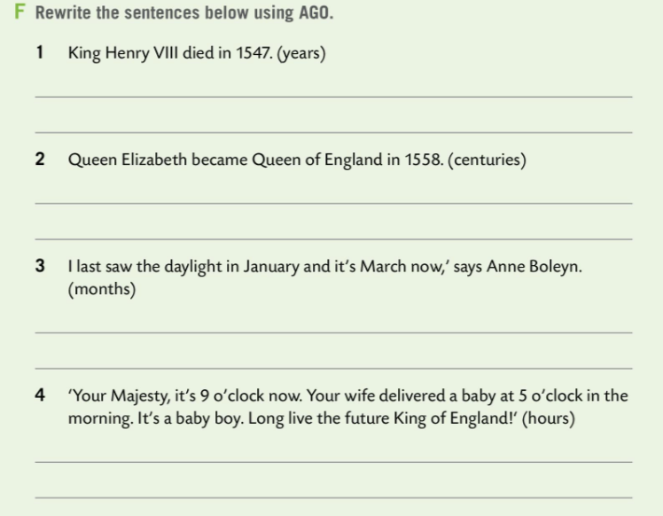
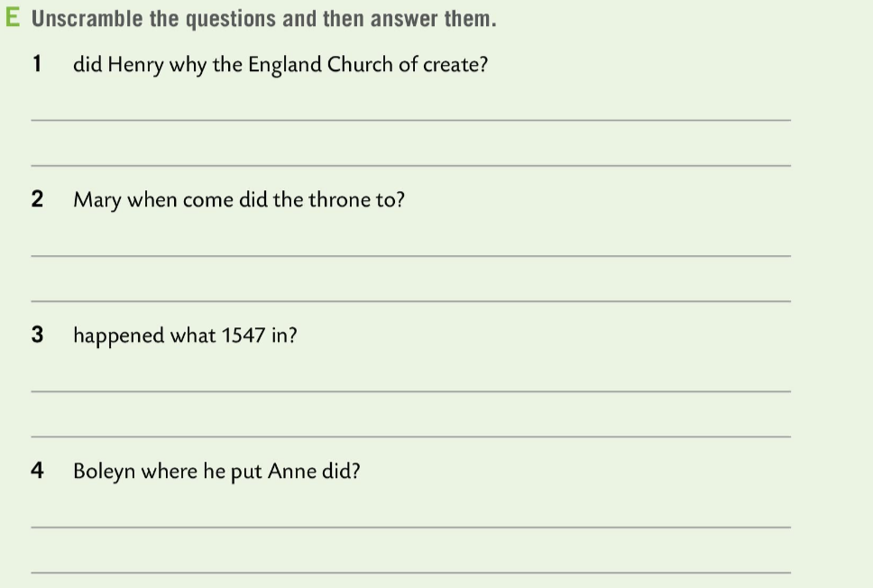
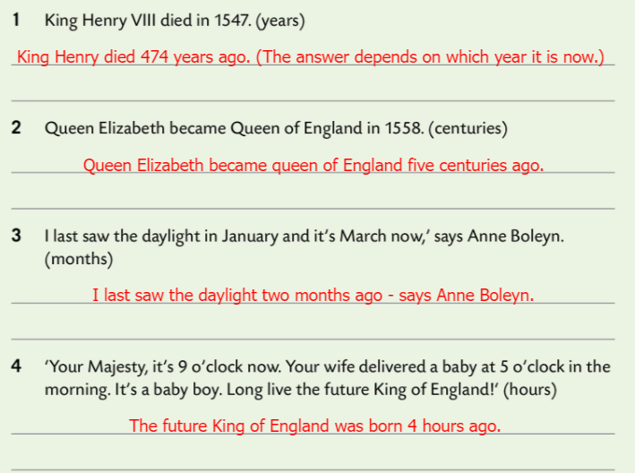
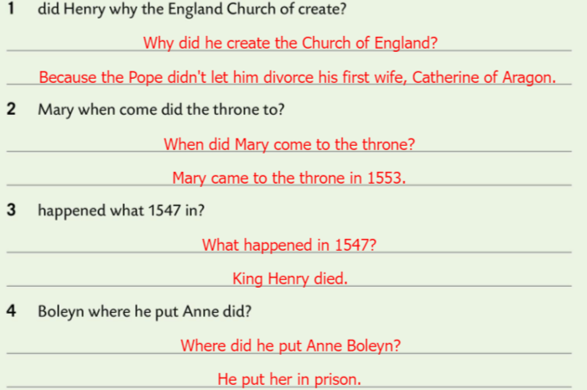
Workbook, page 86. LOOK BACK 3
Unscramble the questions in Task E and then answer them.
Check.
Rewrite the sentences below using AGO.
Check.

Slide 8
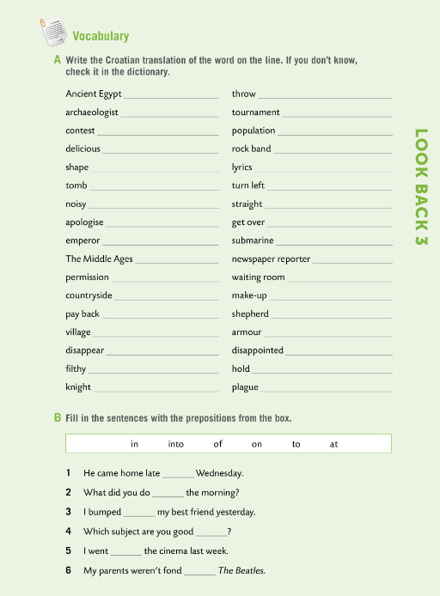
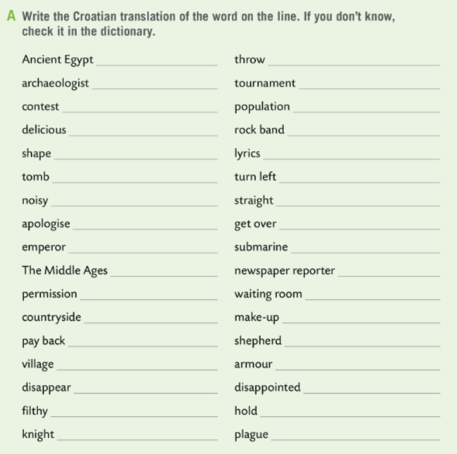
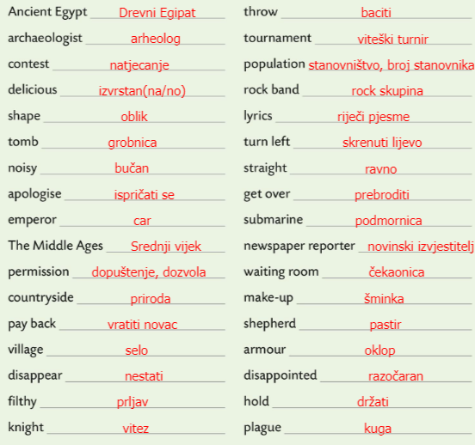
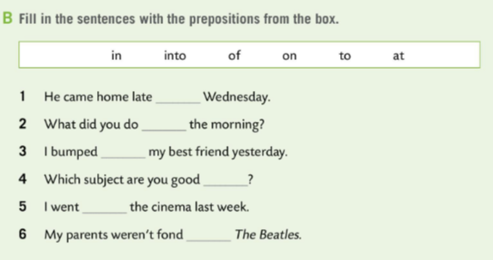
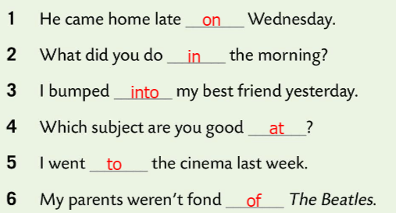
Workbook, page 87. LOOK BACK 3
Write the Croatian translation of the word on the line. If you don’t know, check it in the dictionary.
Check.
Fill in the sentences in Task B with the prepositions from the box.
Check.

Slide 9
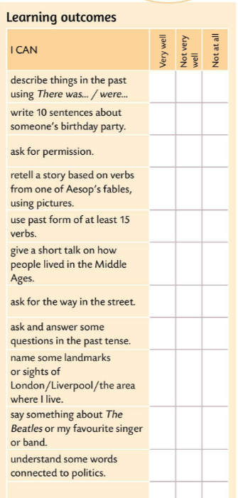

Look at the learning outcomes table.
Which of the outcomes did you master very well?
Which ones need more improvement?
Do you need more time and practice for any of them?
Be honest.

